Slide 1

Product Management Module 4 – Office Hours Oct 29, 2023

Slide 2
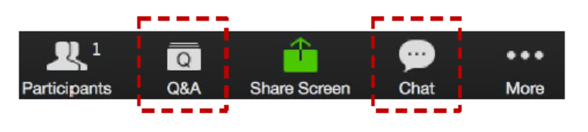
Zoom Chat and Q&A Box
Please type your questions in the Q&A box
Also, ongoing discussion in the Chat
Please enter your questions in the Q&A box. We’ll answer these in the Q&A and stop from time to time to bring these to the broader attention of the class
Please enter your response in the ‘Chat box.’ Before you send it, please make sure that your response goes to ‘Everyone’
Notes:
Please enter your questions in the Q&A box. We’ll answer these in the Q&A and stop from time to time to bring these to the broader attention of the class.
Please enter your response in the ‘Chat box.’ Before you send it, please make sure that your response goes to ‘Everyone’
We will continue to try to make the sessions interactive. Raise your hand if you’d like to talk and we will unmute you. For questions that we can not answer interactively we will take offline and post them in the discussion groups.
Now for today’s agenda

Slide 3



AGENDA
Getting Help
Module Review
Assignment Discussions
Additional Resources
Programme Schedule
Next Week
Q&A
Notes:
In today’s session we will cover the following topics:
Getting Help
Module Review
Assignment Discussions
Additional Resources
Programme Schedule
Next Week
Q&A

Slide 4

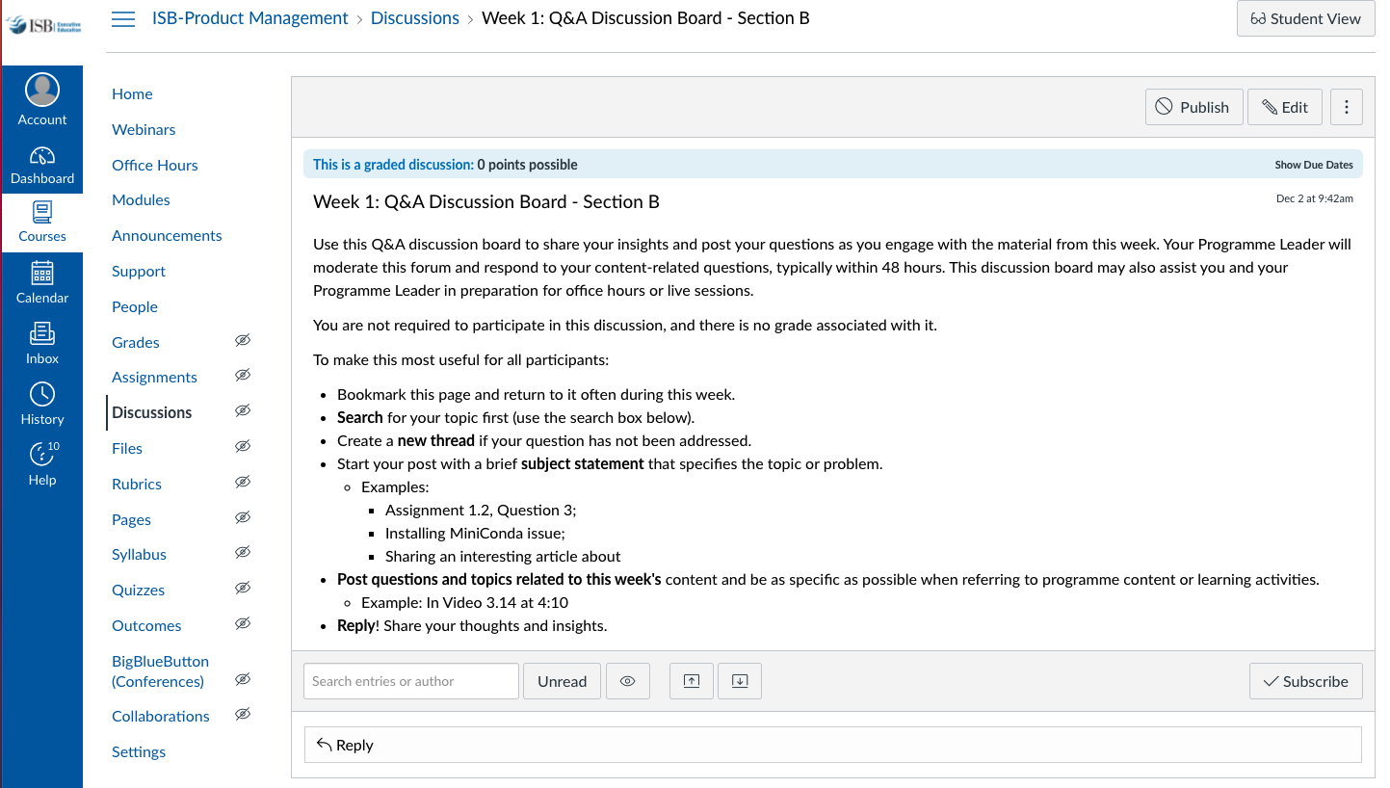
GETTING HELP
Notes:
While I covered this last week, I will continue to cover how to get help for a few more modules.
One of the best resources are your classmates. A great way to learn from them is to engage on the weekly discussion topic. We want to broadly encourage collaboration, though without plagiarism. Share your thoughts, concepts, pluses and minuses though not your actual answers.
These are accessible in the weekly module, though I have highlighted the page where you will be taken.
It is great that many of you are setting up study groups via WhatsApp. We encourage that independent initiative and effort, while the programme leaders can not participate in those groups, we will engage in the group discussions on Canvas. What we will also do is provide some of the additional resources we reference in office hours in these discussions.

Slide 5
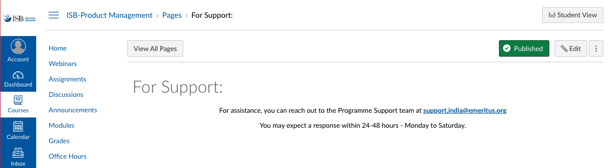
GETTING HELP
Notes:
And for content or assignment related material CLICK
You can reach out to your programme leader via an Inbox email for help. CLICK
Then for support for Canvas and other technical items contact support. This generally includes grading and associated scheduling and requests. When you click the Support tab it takes you to this page. Note that you are asked to send an email to programme.support@eruditus.com. For those of you who may not be in India, note the spelling of program.

Slide 6
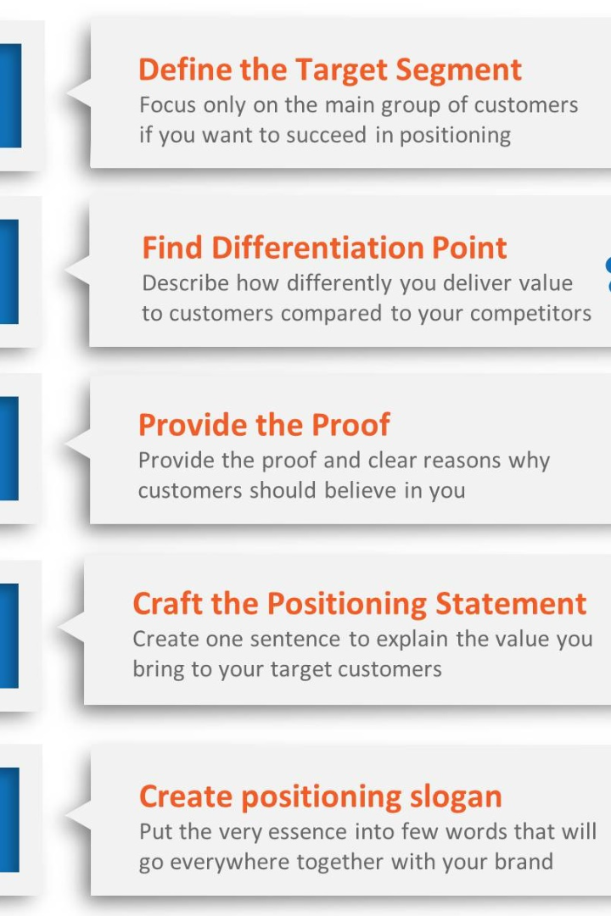
Positioning
Positioning is the process of creating a distinct image and perception of a product or brand in the minds of consumers

Slide 7
Successful Positioning Strategies
Apple
Coca-Cola
Apple has successfully positioned itself as an innovative and premium brand through its sleek designs, user-friendly interfaces, and ecosystem integration.
Coca-Cola has established itself as a timeless and refreshing beverage that brings people together, focusing on emotional connections and universal appeal.
Notes:
\

Slide 8
Factors Contributing to Successful Positioning Strategies
1
Unique Value Proposition
Successful positioning strategies often have a clear and compelling unique value proposition that differentiates them from competitors.
2
Consistent Messaging
Consistency in messaging across various channels helps reinforce and strengthen the desired positioning in the minds of consumers.
Notes:
\

Slide 9

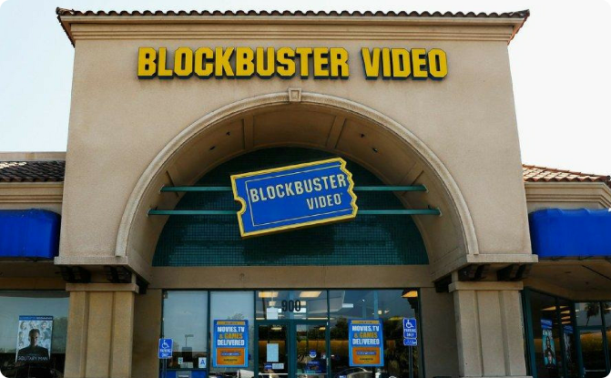
Unsuccessful Positioning Strategies
Kodak
Blockbuster
Kodak failed to adapt to the shift from film to digital photography, resulting in a loss of relevance and market share.
Blockbuster's inability to embrace online streaming and the rise of digital media led to its downfall, ultimately being overtaken by Netflix.
Notes:
\

Slide 10
Lessons Learned
1
Differentiation
Successful positioning requires unique differentiation to stand out from competitors and meet consumer needs.
2
Adaptability
Staying adaptable and willing to evolve with changing consumer preferences and market trends is crucial for long-term success.
3
Listening to Customers
Understanding and responding to customer feedback helps fine-tune positioning strategies and maintain relevance.
Notes:
\

Slide 11


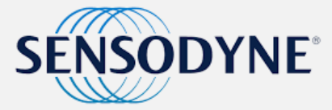

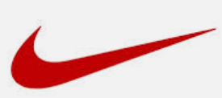

MODULE REVIEW – Positioning Strategies
Positioning Strategy | Example | Messaging | Objective
By Product Characteristics or Customer Benefits |  | Economy and reliability. Sensitive teeth (focus not on whiter/brighter teeth) | Consumers are generally more interested in what such features mean to them “Don’t sell the steak, sell the sizzle”
By Use or Application |  | Soup is good food. | A position that deliberately attempts to expand the brand’s market.
By Product User |  | Michael Jordan as their spokesperson | Associate a product with a user or a class of users
By Product Class |  | As a cleansing cream product | Dove positioned itself apart from the soap category

Slide 12
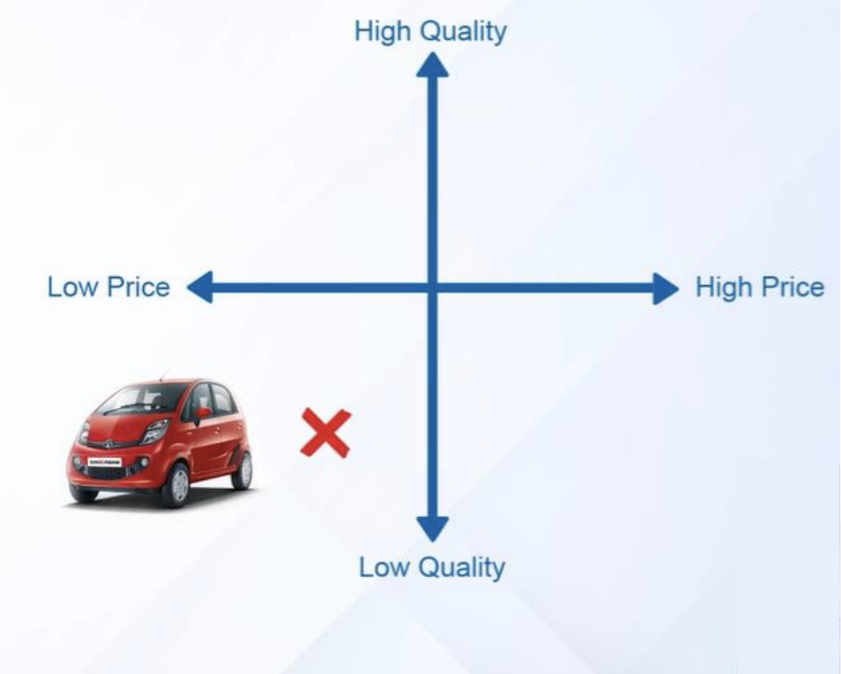
Positioning Problem –Tata Nano
Notes:
One way to set positioning is Disruptive Positioning.
These include Reverse Positioning, Breakaway Positioning and Stealth Positioning.
Let’s briefly cover each of these

Slide 13
Positioning Problem –Examples
Harley Davidson Perfume
McDonald’s Salad Menu (2000s)
Google Glass (2013)
PepsiCo's Tropicana Redesign (2009)
Kellogg's Cornflakes in India (1990s)
Hindustan Unilever's Fair & Lovely (2020)
Notes:
One way to set positioning is Disruptive Positioning.
These include Reverse Positioning, Breakaway Positioning and Stealth Positioning.
Let’s briefly cover each of these

Slide 14
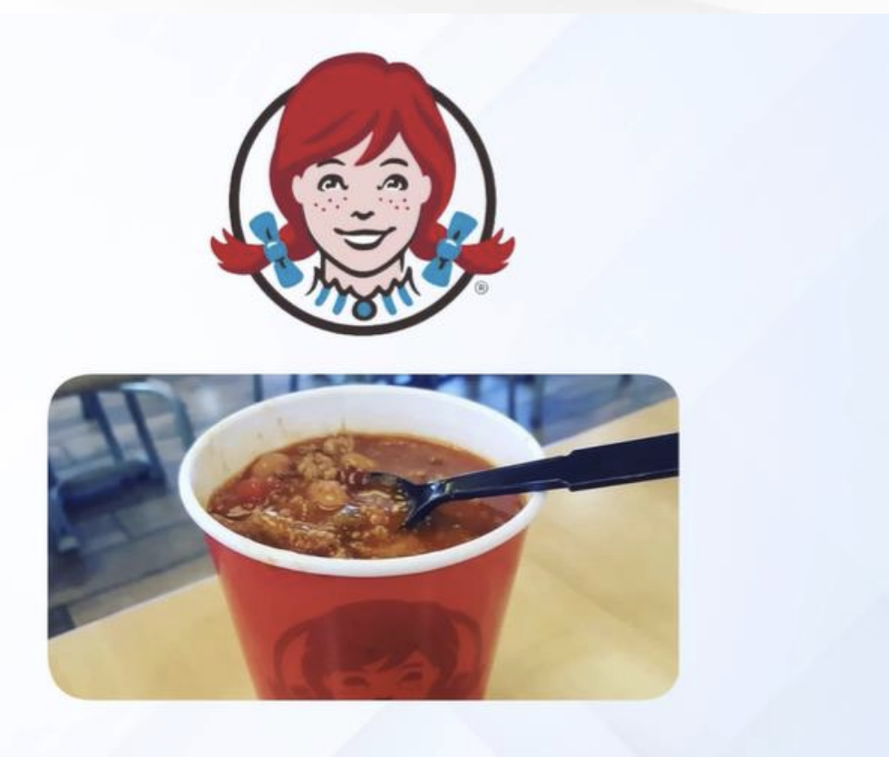

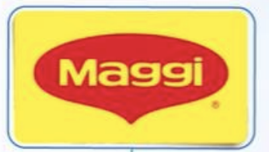
Positioning Problem –Examples

Slide 15


What comes to your mind?
Notes:
One way to set positioning is Disruptive Positioning.
These include Reverse Positioning, Breakaway Positioning and Stealth Positioning.
Let’s briefly cover each of these

Slide 16
Disruptive Positioning- What & Why?
Disruptive positioning involves how a company positions its products or services within an existing market to challenge or change the way customers perceive them.
Market Saturation
Competitive Advantage:
Cost Efficiency
Creating New Markets
Notes:
One way to set positioning is Disruptive Positioning.
These include Reverse Positioning, Breakaway Positioning and Stealth Positioning.
Let’s briefly cover each of these

Slide 17
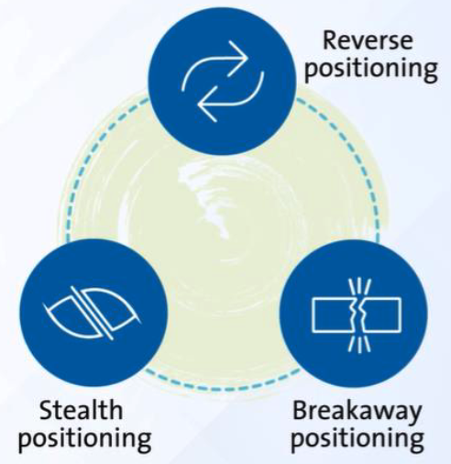
MODULE REVIEW – Disruptive Positioning
Notes:
One way to set positioning is Disruptive Positioning.
These include Reverse Positioning, Breakaway Positioning and Stealth Positioning.
Let’s briefly cover each of these

Slide 18
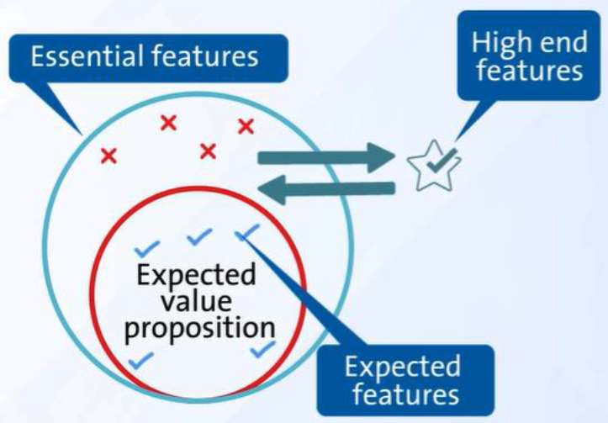
MODULE REVIEW – Reverse Positioning
Notes:
In reverse positioning you strip away what is expected by consumers then add in premium benefits.

Slide 19
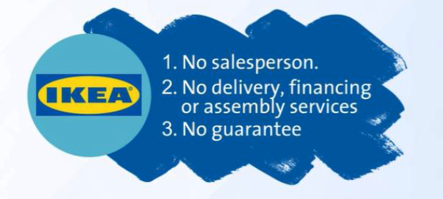
MODULE REVIEW – Reverse Positioning Example
Notes:
Recall the example of IKEA, they basically stripped away many things:
No sales person
No delivery, financing or assembly services
No guarantee
What they added was modular design, buyer assembly, lower prices, packaged for buyer transport . . . Very space efficient.
Also, shopping in their stores was is an experience with great displays of how the products can be configured in small spaces along with a nice dining experience.

Slide 20
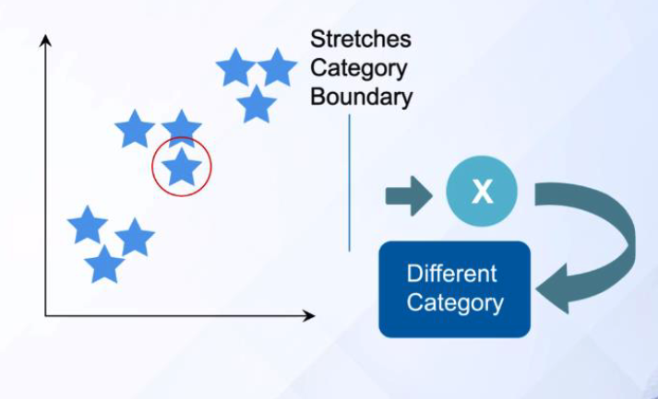
MODULE REVIEW – Breakaway Positioning
Notes:
Breakaway positioning stretches the category boundary to define a new category.

Slide 21
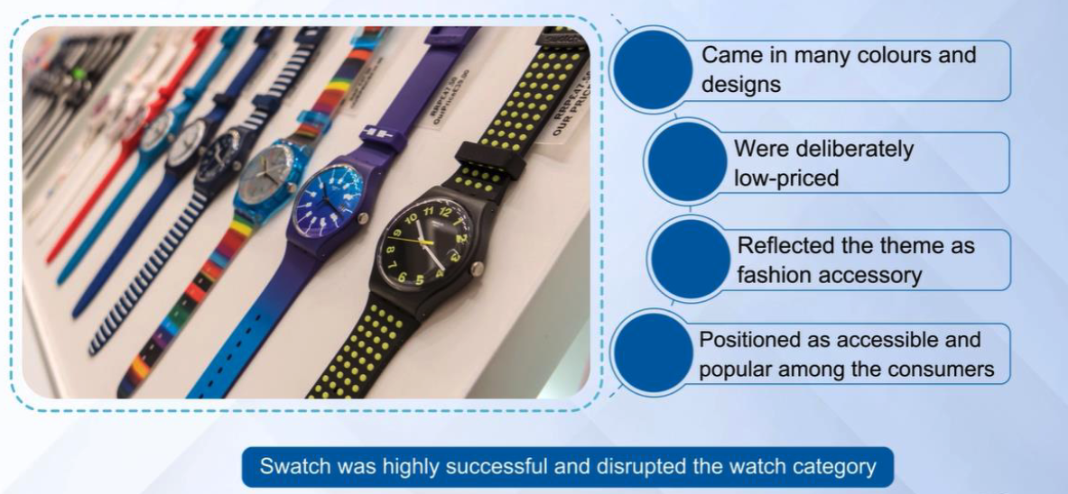
MODULE REVIEW – Breakaway Positioning
Notes:
Recall the Swatch example from the lectures.
Watches were often pieces of fine jewelry and heirlooms.
Timex transitioned it into a tool, something basic and simple to tell time that was also inexpensive
Swatch changed it into a fashion accessory while maintaining the basic function
While still a watch, each transition redefined the category.

Slide 22
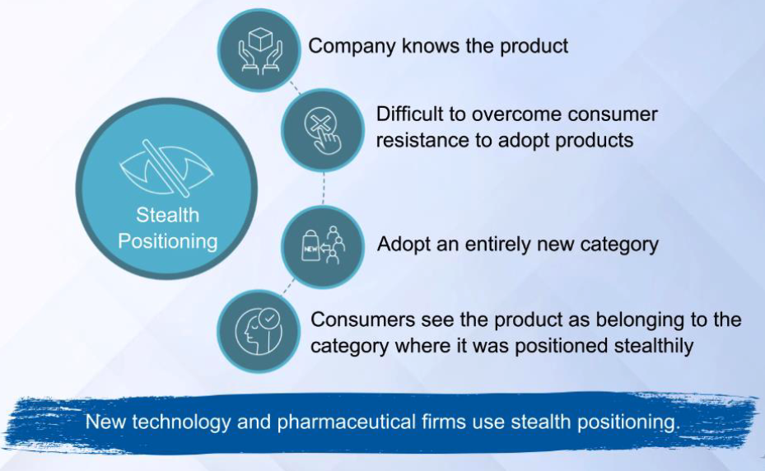
MODULE REVIEW – Stealth Positioning
Notes:
In stealth positioning, the consumer typically sees the product in a category that is somewhat tainted. Though sometimes the marketing itself is stealth.
The company conceals the true nature of their products by affiliating them with a different category.
Consumers may feel intimidated by products in the category, as is often the case with new technologies; They may have reservations about products in the category because previous products failed to live up to expectations; or they may have personal objections to products or companies in the category. Using stealth positioning, companies can, sneak products into the market and gain acceptance that might otherwise prove elusive.

Slide 23
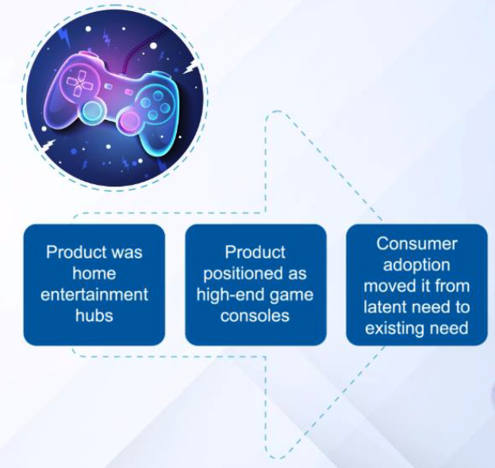
MODULE REVIEW – Stealth Positioning
Notes:
The example professor Siddharth used in the lectures was high-end game consoles. This was done due to the market for home entertainment hubs was either latent or tainted.

Slide 24
Disruptive Positioning vs Disruptive Innovation?
?

Slide 25
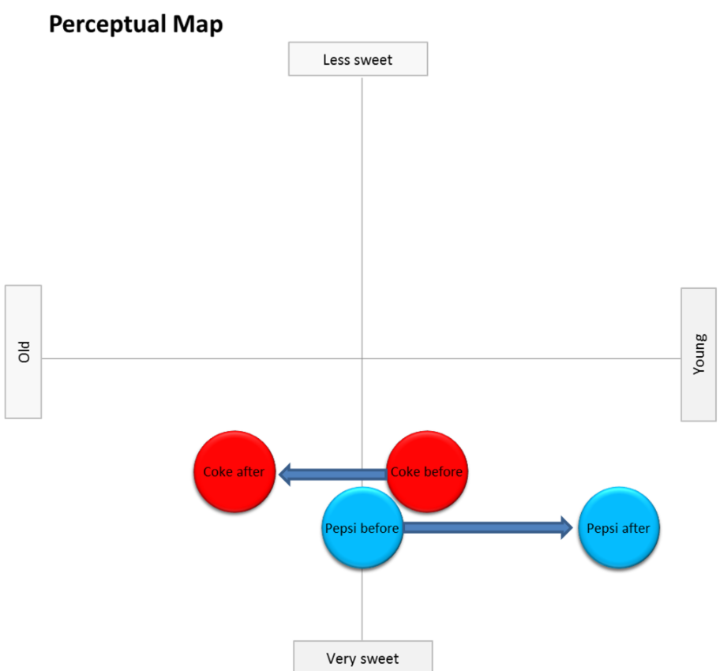
MODULE REVIEW – Perceptual Map
Pepsi’s new generation campaign had the effect of repositioning Coke as “Old and Tired”
Notes:
Pepsi’s new generation campaign had the effect of repositioning Coke as “Old and Tired”

Slide 26
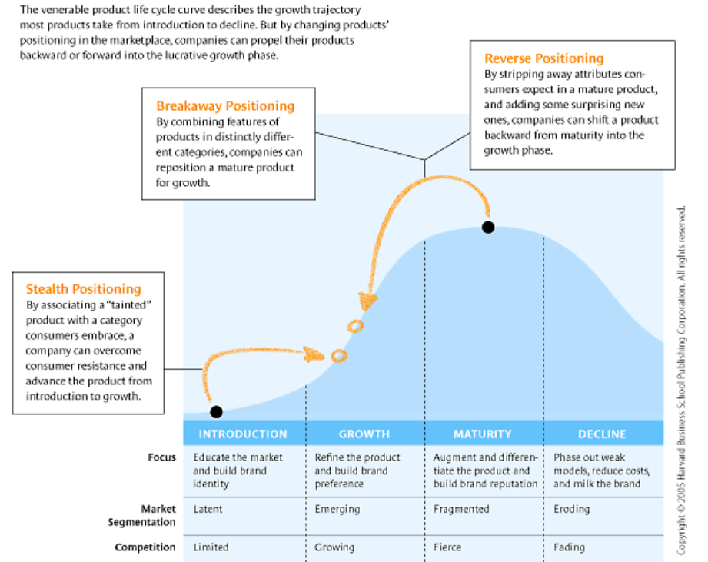
MODULE REVIEW – Reposition for Growth

Slide 27
Reverse Positioning Examples
Reverse Positioning
Commerce Bank Most banks offer dozens of checking and savings accounts and compete by claiming to offer account holders the highest interest rates. Commerce Bank pays among the lowest rates in its market Between 1999 and 2004, Commerce Bank expanded from 120 to 319 branches, deposits quintupled from $5.6 billion to $27.7 billion, and loans tripled from $3 billion to $9.4 billion. After stripping away what customers expect—competitive interest rates and abundant choices—Commerce Bank reverse positioned itself as “the most convenient bank in America.” It’s open seven days a week, including evenings. You can get a debit card while you wait, and, when it rains, an escort with an umbrella will walk you to your car. The bank offers free coffee and newspapers
JetBlue JetBlue achieved its stellar is performance in part by following Southwest’s lead, offering cheap seats and a lean value proposition: no meals, no round-trip fares, and no first-class seating But then it supplemented its bare-bones offering with surprising indulgences like leather seats, high-end personal entertainment systems with satellite television, and extra legroom in the back two-thirds of the plane.
Notes:
Let’s walk through a few examples.
Reverse Positioning
Commerce Bank
Most banks offer dozens of checking and savings accounts and compete by claiming to offer account holders the highest interest rates.
Commerce Bank pays among the lowest rates in its market
Between 1999 and 2004, Commerce Bank expanded from 120 to 319 branches, deposits quintupled from $5.6 billion to $27.7 billion, and loans tripled from $3 billion to $9.4 billion.
After stripping away what customers expect—competitive interest rates and abundant choices—Commerce Bank reverse positioned itself as “the most convenient bank in America.”
It’s open seven days a week, including evenings. You can get a debit card while you wait, and, when it rains, an escort with an umbrella will walk you to your car. The bank offers free coffee and newspapers
JetBlue
JetBlue achieved its stellar is performance in part by following Southwest’s lead, offering cheap seats and a lean value proposition: no meals, no round-trip fares, and no first-class seating
But then it supplemented its bare-bones offering with surprising indulgences like leather seats, high-end personal entertainment systems with satellite television, and extra legroom in the back two-thirds of the plane.
Breakaway Positioning
Nintendo
Rewrote the rules of the electronic gaming market, taking an activity long seen as solitary and sedentary and turning it into healthy, often communal play that inspires everything from learning to quality family time.
Through innovative new gaming consoles, the Wii and handheld DS, Nintendo has broadened its appeal to all ages, particularly targeting those who weren't previously interested in videogames.
The DS is marketed primarily as a teaching toy, or one to help exercise the mind--a personal handheld gaming device on which to solve puzzles and brainteasers.
Nike
Focusing on innovation and performance, Nike was able to position itself well to target serious athletes.
The brand today offers not just shoes but also the complete attire to be worn by athletes which in turn helps to enhance their performance.
Their tagline “Just Do It” and its models are here to promote serious fitness.
Stealth Positioning
Starbucks
In 2015, Starbucks started what turned out to be a nationwide controversy regarding the design of their traditional Christmas cups.
The design was thought by some to be very understated, too plain and even – not Christmassy enough!
Pundits, consumers and critics made their voices heard and their opinions known about the lack of elaborate cup design.
It later turned out that the controversy was fake: very few people actually hated the cup, but the stir caused Starbucks’ sales to soar.
2 States – Sunsilk
2 States is a Bollywood movie based on Chetan Bhagat’s novel. In the movie, a few glimpses of Sunsilk are visible. The main protagonist gets a job as a brand manager in Sunsilk, and the brand’s logo is visible in a few scenes. It is a smart way of placement of brand Sunsilk in the movie.

Slide 28
Breakaway Positioning Examples
Breakaway Positioning
Nintendo Rewrote the rules of the electronic gaming market, taking an activity long seen as solitary and sedentary and turning it into healthy, often communal play that inspires everything from learning to quality family time. Through innovative new gaming consoles, the Wii and handheld DS, Nintendo has broadened its appeal to all ages, particularly targeting those who weren't previously interested in videogames. The DS is marketed primarily as a teaching toy, or one to help exercise the mind--a personal handheld gaming device on which to solve puzzles and brainteasers.
Nike Focusing on innovation and performance, Nike was able to position itself well to target serious athletes. The brand today offers not just shoes but also the complete attire to be worn by athletes which in turn helps to enhance their performance. Their tagline “Just Do It” and its models are here to promote serious fitness.
Notes:
Let’s walk through a few examples.
Reverse Positioning
Commerce Bank
Most banks offer dozens of checking and savings accounts and compete by claiming to offer account holders the highest interest rates.
Commerce Bank pays among the lowest rates in its market
Between 1999 and 2004, Commerce Bank expanded from 120 to 319 branches, deposits quintupled from $5.6 billion to $27.7 billion, and loans tripled from $3 billion to $9.4 billion.
After stripping away what customers expect—competitive interest rates and abundant choices—Commerce Bank reverse positioned itself as “the most convenient bank in America.”
It’s open seven days a week, including evenings. You can get a debit card while you wait, and, when it rains, an escort with an umbrella will walk you to your car. The bank offers free coffee and newspapers
JetBlue
JetBlue achieved its stellar is performance in part by following Southwest’s lead, offering cheap seats and a lean value proposition: no meals, no round-trip fares, and no first-class seating
But then it supplemented its bare-bones offering with surprising indulgences like leather seats, high-end personal entertainment systems with satellite television, and extra legroom in the back two-thirds of the plane.
Breakaway Positioning
Nintendo
Rewrote the rules of the electronic gaming market, taking an activity long seen as solitary and sedentary and turning it into healthy, often communal play that inspires everything from learning to quality family time.
Through innovative new gaming consoles, the Wii and handheld DS, Nintendo has broadened its appeal to all ages, particularly targeting those who weren't previously interested in videogames.
The DS is marketed primarily as a teaching toy, or one to help exercise the mind--a personal handheld gaming device on which to solve puzzles and brainteasers.
Nike
Focusing on innovation and performance, Nike was able to position itself well to target serious athletes.
The brand today offers not just shoes but also the complete attire to be worn by athletes which in turn helps to enhance their performance.
Their tagline “Just Do It” and its models are here to promote serious fitness.
Stealth Positioning
Starbucks
In 2015, Starbucks started what turned out to be a nationwide controversy regarding the design of their traditional Christmas cups.
The design was thought by some to be very understated, too plain and even – not Christmassy enough!
Pundits, consumers and critics made their voices heard and their opinions known about the lack of elaborate cup design.
It later turned out that the controversy was fake: very few people actually hated the cup, but the stir caused Starbucks’ sales to soar.
2 States – Sunsilk
2 States is a Bollywood movie based on Chetan Bhagat’s novel. In the movie, a few glimpses of Sunsilk are visible. The main protagonist gets a job as a brand manager in Sunsilk, and the brand’s logo is visible in a few scenes. It is a smart way of placement of brand Sunsilk in the movie.

Slide 29
Stealth Positioning Examples
Stealth Positioning
Starbucks In 2015, Starbucks started what turned out to be a nationwide controversy regarding the design of their traditional Christmas cups. The design was thought by some to be very understated, too plain and even – not Christmassy enough! Pundits, consumers and critics made their voices heard and their opinions known about the lack of elaborate cup design. It later turned out that the controversy was fake: very few people actually hated the cup, but the stir caused Starbucks’ sales to soar.
2 States – Sunsilk 2 States is a Bollywood movie based on Chetan Bhagat’s novel. In the movie, a few glimpses of Sunsilk are visible. The main protagonist gets a job as a brand manager in Sunsilk, and the brand’s logo is visible in a few scenes. It is a smart way of placement of brand Sunsilk in the movie.
Notes:
Let’s walk through a few examples.
Reverse Positioning
Commerce Bank
Most banks offer dozens of checking and savings accounts and compete by claiming to offer account holders the highest interest rates.
Commerce Bank pays among the lowest rates in its market
Between 1999 and 2004, Commerce Bank expanded from 120 to 319 branches, deposits quintupled from $5.6 billion to $27.7 billion, and loans tripled from $3 billion to $9.4 billion.
After stripping away what customers expect—competitive interest rates and abundant choices—Commerce Bank reverse positioned itself as “the most convenient bank in America.”
It’s open seven days a week, including evenings. You can get a debit card while you wait, and, when it rains, an escort with an umbrella will walk you to your car. The bank offers free coffee and newspapers
JetBlue
JetBlue achieved its stellar is performance in part by following Southwest’s lead, offering cheap seats and a lean value proposition: no meals, no round-trip fares, and no first-class seating
But then it supplemented its bare-bones offering with surprising indulgences like leather seats, high-end personal entertainment systems with satellite television, and extra legroom in the back two-thirds of the plane.
Breakaway Positioning
Nintendo
Rewrote the rules of the electronic gaming market, taking an activity long seen as solitary and sedentary and turning it into healthy, often communal play that inspires everything from learning to quality family time.
Through innovative new gaming consoles, the Wii and handheld DS, Nintendo has broadened its appeal to all ages, particularly targeting those who weren't previously interested in videogames.
The DS is marketed primarily as a teaching toy, or one to help exercise the mind--a personal handheld gaming device on which to solve puzzles and brainteasers.
Nike
Focusing on innovation and performance, Nike was able to position itself well to target serious athletes.
The brand today offers not just shoes but also the complete attire to be worn by athletes which in turn helps to enhance their performance.
Their tagline “Just Do It” and its models are here to promote serious fitness.
Stealth Positioning
Starbucks
In 2015, Starbucks started what turned out to be a nationwide controversy regarding the design of their traditional Christmas cups.
The design was thought by some to be very understated, too plain and even – not Christmassy enough!
Pundits, consumers and critics made their voices heard and their opinions known about the lack of elaborate cup design.
It later turned out that the controversy was fake: very few people actually hated the cup, but the stir caused Starbucks’ sales to soar.
2 States – Sunsilk
2 States is a Bollywood movie based on Chetan Bhagat’s novel. In the movie, a few glimpses of Sunsilk are visible. The main protagonist gets a job as a brand manager in Sunsilk, and the brand’s logo is visible in a few scenes. It is a smart way of placement of brand Sunsilk in the movie.

Slide 30
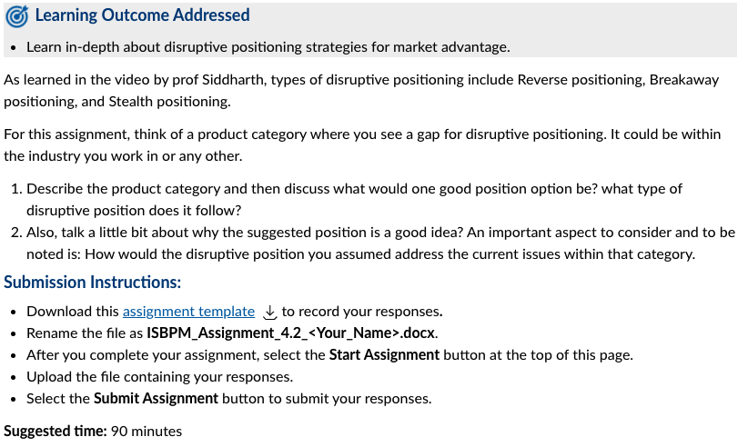
ASSIGNMENT 4.2 PROBLEM
Notes:
As learned in the video by prof Siddharth, types of disruptive positioning include Reverse positioning, Breakaway positioning, and Stealth positioning.
For this assignment, think of a product category where you see a gap for disruptive positioning. It could be within the industry you work in or any other.
Describe the product category and then discuss what would one good position option be? what type of disruptive position does it follow?
Also, talk a little bit about why the suggested position is a good idea? An important aspect to consider and to be noted is: How would the disruptive position you assumed address the current issues within that category.
Submission Instructions:
Download this assignment template Download assignment templateto record your responses.
Rename the file as ISBPM_Assignment_4.2_<Your_Name>.docx.
After you complete your assignment, select the Start Assignment button at the top of this page.
Upload the file containing your responses.
Select the Submit Assignment button to submit your responses.
CLICK
Suggested time: 90 minutes

Slide 31
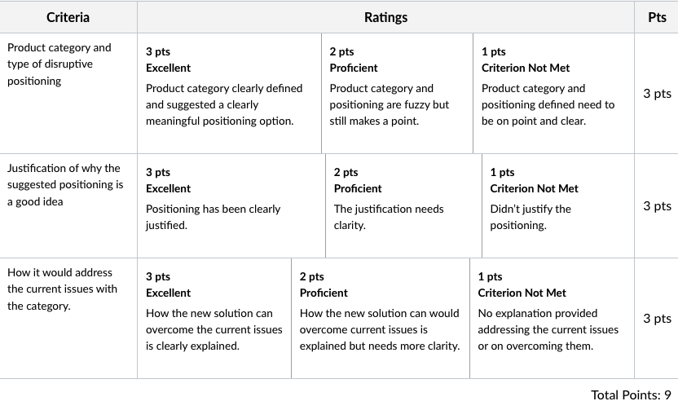
ASSIGNMENT 4.2 RUBRIC
Notes:
The document is looking for 3 things, each worth the same amount, 3 points each, for a total of 9 points.
We’ll use each of these as the topics for discussion

Slide 32
ASSIGNMENT DISCUSSION
Product category and type of disruptive positioning
Justification of why the suggested positioning is a good idea
How it would address the current issues with the category
Notes:
Product category and type of disruptive positioning
Justification of why the suggested positioning is a good idea
How it would address the current issues with the category
Should I add an additional slide as an example????

Slide 33

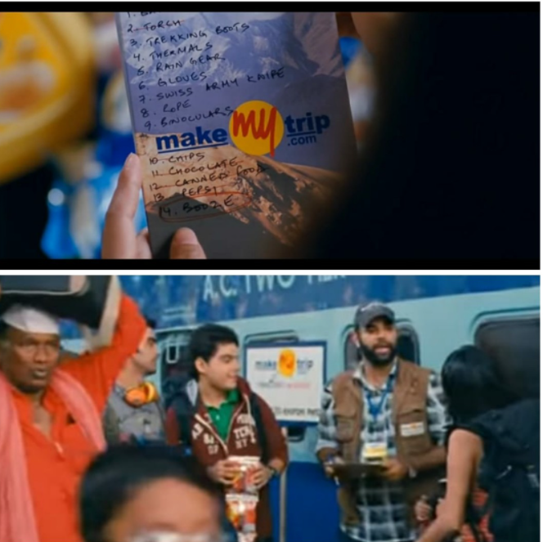
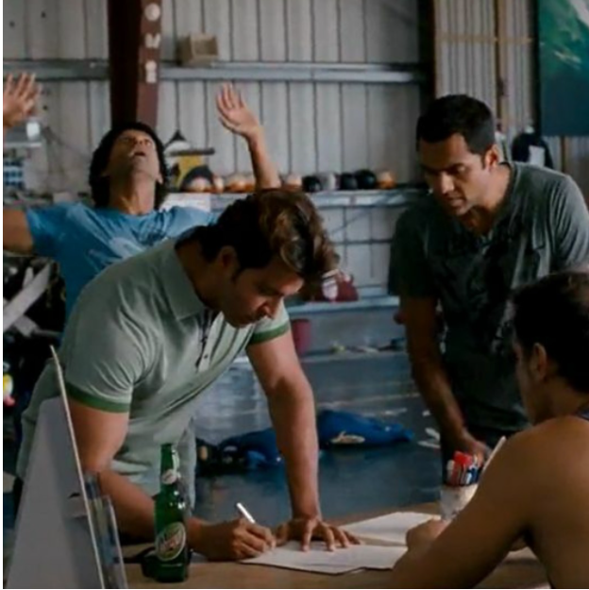
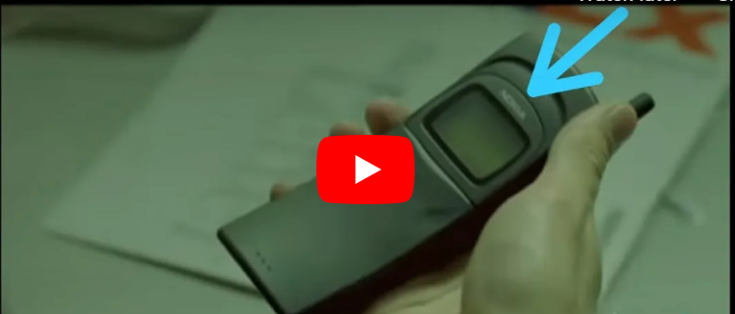
MODULE REVIEW – Identify the Brand and Movie
Top Gun – Rayban
Yeh Jawani Hai Deewani - MakeMyTrip
Zindagi Na Milegi Dobara - Mountain Dew
The Matrix – Nokia
Notes:
We are going to have a short interactive quiz. It is about Stealth positioning done via product placement. Type your answers in the Chat as we show each image. We’ll then reveal the movie and the braind
CLICK
Wait about 30 seconds
CLICK
Top Gun is the Movie, Rayban Sunglasses is the brand
CLICK
Wait about 30 seconds
CLICK
The Matrix is the Movie, Nokia is the brand
CLICK
Wait about 30 seconds
CLICK
Yeh Jawani Hai Deewani is the Movie, MakeMyTrip is the brand
CLICK
Wait about 30 seconds
Zindagi Na Milegi Dobara is the movie, Mountain Dew is the brand

Slide 34
QUESTIONS FROM DISCUSSION BOARDS AND IN-BOX
What is the difference between Product Market and Product Category?
Notes:
What is the difference between Product market & product category?
We will use automobiles as the example:
Automobiles is the product market
High-end luxury cars is a category
Also, I see that some of you did some wireframes. That is great, now consider how you would test and whether you should have multiple versions to test.

Slide 35
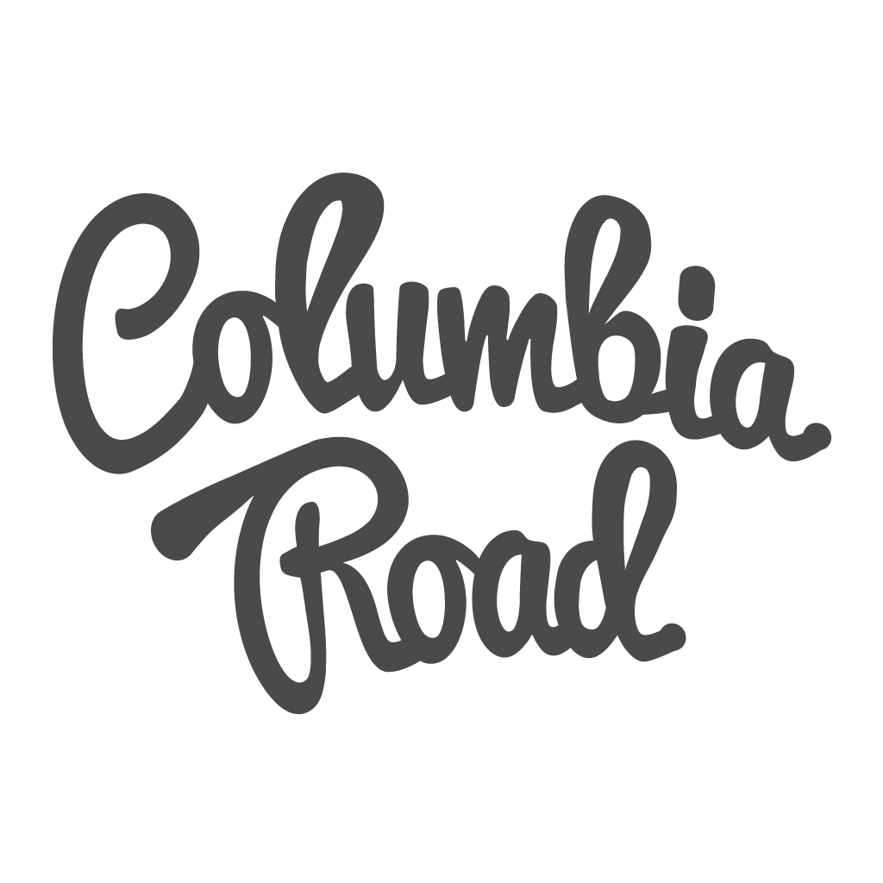

QUESTIONS FROM DISCUSSION BOARDS AND IN-BOX
I’d like to learn more about customer journey maps. Are there resources for this?
Notes:
If you do a search on Customer Journey Map Template you will find many resources. Here are a couple that I like:
CLICK
Hibspot has a lot of great free tools. They have a number of customer journey templates.
https://blog.hubspot.com/service/customer-journey-map
CLICK
One I particularly like comes from the Columbia Road website. The reason I like this one is that it goes beyond the sales step to add a bit more, including Loyalty and Advocacy.
https://www.columbiaroad.com/blog/why-and-how-to-create-a-customer-journey-map-download-free-template

Slide 36
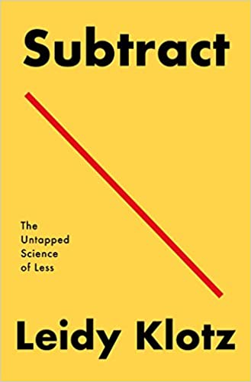

ADDITIONAL RESOURCES
Notes:
This week here are a couple of additional resources:
First, a book Subtract by Leidy Klotz - Subtract: explores the other approach to problem-solving: proving why we overlook subtraction, and how we can access its untapped potential. This can help you with Reverse Positioning.
Note that over the years Apple has often lead the way in reverse positioning in the computer industry. When they released the iMac it took out the floppy disk drive and added in a CD/DVD drive and a network connection. They also eliminated the standard connector for things like the keyboard and mouse and replaced it with USB. Looking back on it now it makes a lot of sense, though at the time it was viewed by many as a huge mistake.
https://amzn.to/3APbsoo
And the Harvard Business School Working Knowledge website has a nice short article on Stealth Positioning
https://hbswk.hbs.edu/item/rescuing-products-with-stealth-positioning

Slide 37
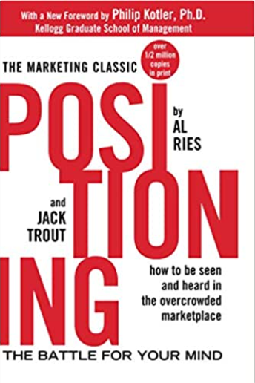
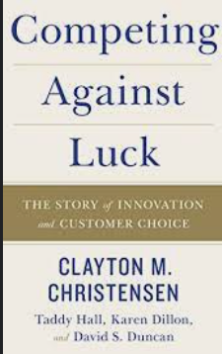
ADDITIONAL RESOURCES
Notes:
Positioning is a critical skill.
CLICK
Here is a great book on Positioning by Al Ries and Jack Trout:
https://amzn.to/34KFzSS
Another great book is
CLICK
Competing against Luck by Clayton Christensen – In the book professor Christensen contends that customers don't buy products or services; they "hire" them to do a job. Understanding customers does not drive innovation success, Understanding customer jobs does.
https://amzn.to/3tig0CR

Slide 38


ADDITIONAL RESOURCES
Notes:
CLICK
While the Harvard Business Review is a paid subscription service they make a number of articles available for free.
While a little old there is a very good article on Mapping Your Competitive Position.
https://hbr.org/2007/11/mapping-your-competitive-position
CLICK
Blogs are often a great resource. Here is an article from Nulab, Here is a recent article by Georgina Guthrie, How to get started with a competitive positioning strategy
https://nulab.com/blog/startups/how-to-get-started-with-a-competitive-positioning-strategy/

Slide 39
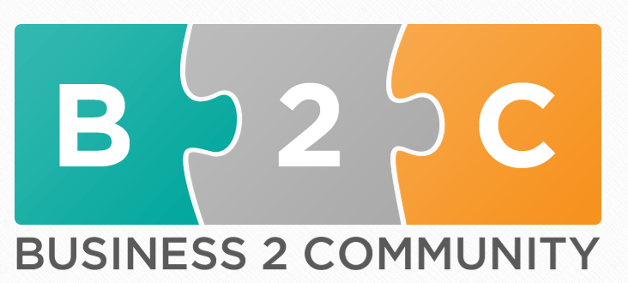
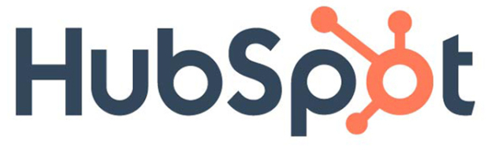
ADDITIONAL RESOURCES
Notes:
CLICK
Hubspot has a number of available free resources as an enticement to use their service. There blog is quite good.
There is a very good article titled A Complete Guide to Successful Brand Positioning
https://blog.hubspot.com/sales/brand-positioning-strategy
The article allows you to download a number of brand templates.
CLICK
And another community blog, Business 2 Community has a good article on positioning titled Positioning: 5 Strategies to Stand Out From Your Competitors by Daniel Hopper
https://www.business2community.com/strategy/positioning-5-strategies-to-stand-out-from-your-competitors-02333056

Slide 40
NEXT WEEK
Course/Program learning outcomes addressed this week:
Evaluate product road-mapping and prototyping decisions using various product management techniques & practices.
Outline a plan to create a competitive scalable product using key product development strategies & frameworks.
By the end of this week, you will be able to:
Distinguish products, the commonly considered types of new products and the factors impacting their success and failure.
Discuss the implications of the context of a new product development process or NPD process on its applications.
Understand how to make decisions about how fast or slow the NPD process should be in any given context.
Explain how during the NPD process, a company uses marketing research to obtain information from potential consumers to improve a product concept.
Understand what information is needed from potential consumers and the means to get the same, and when you can go to market with a minimum viable product or MVP, given the context of your NPD process.
Define causality, reasons for conducting experiments and issues of validity in your experiments.
Describe A/B and A/A testing and growth hacking.
Notes:
In it we will cover:
CLICK
Course/Program learning outcomes addressed this week:
Evaluate product road-mapping and prototyping decisions using various product management techniques & practices.
Outline a plan to create a competitive scalable product using key product development strategies & frameworks.
By the end of this week, you will be able to:
Distinguish products, the commonly considered types of new products and the factors impacting their success and failure.
Discuss the implications of the context of a new product development process or NPD process on its applications.
Understand how to make decisions about how fast or slow the NPD process should be in any given context.
Explain how during the NPD process, a company uses marketing research to obtain information from potential consumers to improve a product concept.
Understand what information is needed from potential consumers and the means to get the same, and when you can go to market with a minimum viable product or MVP, given the context of your NPD process.
Define causality, reasons for conducting experiments and issues of validity in your experiments.
Describe A/B and A/A testing and growth hacking.

Slide 41

Over to you!

Slide 42
QUESTIONS FROM DISCUSSION BOARDS AND IN-BOX
I have a query regarding Required Assignment 4.2: Understanding Disruptive Positioning.
This time there is no mention about brevity. What is the word limit for this assignment?
Notes:
I have a query regarding Required Assignment 4.2: Understanding Disruptive Positioning.
This time there is no mention about brevity. What is the word limit for this assignment?
While there is no word limit or brevity requirement consider working in a large company where you will need to communicate information to quite a few people. The ability to distill information to its fundamentals is a critical quality.

